Slide 1

Save the Date

Slide 2
Endoscopic Cyst Gastrostomy for Pancreatic Pseudocysts: Single center experience

Slide 3
Faculty Disclosure
x | No, Nothing to Disclose

Slide 4
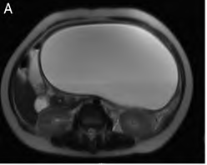
Background
5-15% patients with pancreatitis
Pseudocyst is a collection of amylase rich fluid in the lesser sac
Has a fibrous wall devoid of epithelium
Secondary to medical or surgical causes of pancreatitis
Werlin SL et al JPGN 2003
D'Egidio A Br J Surg 1991

Slide 5
Management of Pseudocysts
Surgical
  Conventional: open surgical drainage (cyst gastrostomy/jejunostomy)
  Laparoscopic: internal drainage
  Percutaneous
        Morton JM J Gastro Surg 2005
        Szako L Pancreatology 2020
        Farias GF Medicine 2019
Endoscopic
  EUS assisted
  EUS un-assisted
        Varadarajulu S GI Endosc 2008
        Lakhtakia S GI Endosc 2015
        Ramesh J JPGN 2013

Slide 6
Patient Characteristics
 | Case 1 | Case 2 | Case 3
Age at presentation | 10y 3m | 2y 4m | 6y 6m
Etiology | Pancreatic trauma (handlebar injury) | Haemorrhagic pancreatitis secondary to L-Asparaginase | Necrotic pancreatitis (idiopathic)
Peak amylase level | 2307 | 111 | 241
Size of Pseudocyst | 8X15X10 cm | 6X8X9cm | 11X7X10cm
E-CG done (day of illness) | Day 36 Day 47 | Day 12 | Day 18
Hospital stay (days) | 50 | 6 | 54
Need for further intervention | Repeat E-CG Laparoscopic cyst gastrostomy | No | No
Stent removal | No | No | No
Complications post E-CG (including recurrence) | Re-accumulation of pseudocyst | None | None

Slide 7
Procedural technique
All procedures under GA
Therapeutic endoscope (3.2mm diameter)
Enterocystotome (Cook Medical)
Single/double pig-tailed biliary stent 7Fr
Subsequent clinical and lab follow up

Slide 8
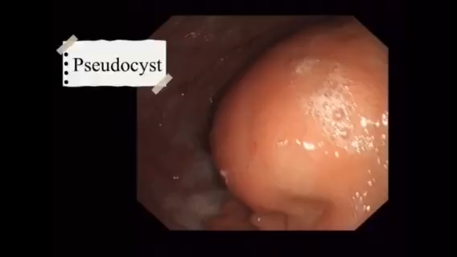

Slide 9
Case selection for endoscopic management of Pseudocysts
Symptomatic
Mature/rapidly enlarging cysts
Diameter of >6cm
Abutting the stomach wall
Clear internal fluid
Endoscopic expertise
Hao W Pancreas 2021

Slide 10
Complications
Bleeding
Failure of Intervention
Cyst re-accumulation
Infection
Perforation
Rosenfeld E, Ped Surg Int 2019
Andalib I, Clin Gastro 2018

